Slide 1
LL37 and Shock Waves

Slide 2
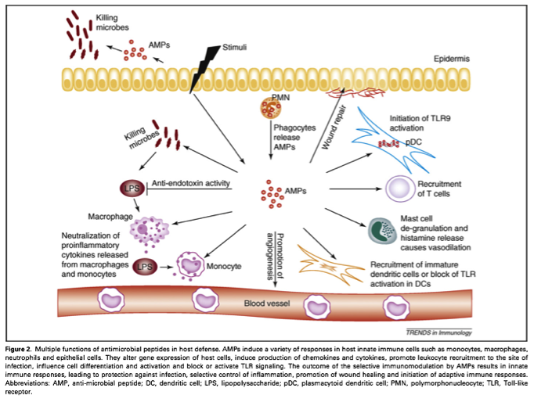
antimicrobial peptides
Lai Y, Gallo RL. AMPed up immunity: how antimicrobial peptides have multiple roles in immune defense. Trends Immunol. 2009;30(3):131-41.
Notes:
Figure 2. Potential interplay of lipids and inflammation with genetics in the pathogenesis of valve calcification. Lipids, especially oxidized lipids, may induce osteoblastic differentiation of fibroblasts by upregulating expression of BMP2, which activates the Wnt/Lrp5/β-catenin pathway through upregulation of the transcription factor, Msx2. In addition, multiple cytokines, including TNF-α, IL-1β, and RANKL, may also promote calcification by activation of this pathway. However, a recent preliminary report has suggested that hypercholesterolemia is also associated with activation of the Runx2/Cbfa1 pathway in aortic valve disease. In addition, increased phosphate (PO4) levels, as are seen in chronic kidney disease, might promote valve calcification through upregulation of Runx2/Cbfa1. Genetic factors may interact to further promote osteoblastic differentiation. NOTCH1 is shown as one example of how a genetic abnormality might contribute to both valvular morphological abnormalities and valvular calcification. The reader is cautioned that NOTCH1 is presented as a proof-of-principle only, as mutations in this gene have to date been associated with valvular lesions in just 2 families. NOTCH1 normally inhibits osteoblast differentiation by repressing the hairy-related family of transcription factors (Hrt), thereby also repressing the Runx2/Cbfa1 pathway. The presence of normal NOTCH1 protein maintains the normal valve phenotype by allowing normal fibroblast differentiation and, secondarily, normal synthesis of structural collagen and elastin. Mutations in the NOTCH1 gene (which are associated with bicuspid aortic valves) lead to osteoblastic differentiation because the NOTCH1 protein is no longer able to repress Hrt and the Runx2/Cbfa1 osteoblast differentiation pathway. Particularly in the setting of lipid/inflammatory stimulation of osteoblastogenesis, the proosteoblastic phenotype resulting from mutations in NOTCH1, its downstream regulatory factors, or other genetic abnormalities, may also lead to pathological calcification.

Slide 3
antimicrobial peptides
LL37 is an antimicrobial peptide which is released upon mechanical stress. It builds complexes with RNA and can thus activate Toll-like receptors and mediate inflammation.
Lai Y, Gallo RL. AMPed up immunity: how antimicrobial peptides have multiple roles in immune defense. Trends Immunol. 2009;30(3):131-41.
Notes:
Figure 2. Potential interplay of lipids and inflammation with genetics in the pathogenesis of valve calcification. Lipids, especially oxidized lipids, may induce osteoblastic differentiation of fibroblasts by upregulating expression of BMP2, which activates the Wnt/Lrp5/β-catenin pathway through upregulation of the transcription factor, Msx2. In addition, multiple cytokines, including TNF-α, IL-1β, and RANKL, may also promote calcification by activation of this pathway. However, a recent preliminary report has suggested that hypercholesterolemia is also associated with activation of the Runx2/Cbfa1 pathway in aortic valve disease. In addition, increased phosphate (PO4) levels, as are seen in chronic kidney disease, might promote valve calcification through upregulation of Runx2/Cbfa1. Genetic factors may interact to further promote osteoblastic differentiation. NOTCH1 is shown as one example of how a genetic abnormality might contribute to both valvular morphological abnormalities and valvular calcification. The reader is cautioned that NOTCH1 is presented as a proof-of-principle only, as mutations in this gene have to date been associated with valvular lesions in just 2 families. NOTCH1 normally inhibits osteoblast differentiation by repressing the hairy-related family of transcription factors (Hrt), thereby also repressing the Runx2/Cbfa1 pathway. The presence of normal NOTCH1 protein maintains the normal valve phenotype by allowing normal fibroblast differentiation and, secondarily, normal synthesis of structural collagen and elastin. Mutations in the NOTCH1 gene (which are associated with bicuspid aortic valves) lead to osteoblastic differentiation because the NOTCH1 protein is no longer able to repress Hrt and the Runx2/Cbfa1 osteoblast differentiation pathway. Particularly in the setting of lipid/inflammatory stimulation of osteoblastogenesis, the proosteoblastic phenotype resulting from mutations in NOTCH1, its downstream regulatory factors, or other genetic abnormalities, may also lead to pathological calcification.

Slide 4
hypothesis
LL37 is released upon SWT and complexes extracellular.
Notes:
Figure 2. Potential interplay of lipids and inflammation with genetics in the pathogenesis of valve calcification. Lipids, especially oxidized lipids, may induce osteoblastic differentiation of fibroblasts by upregulating expression of BMP2, which activates the Wnt/Lrp5/β-catenin pathway through upregulation of the transcription factor, Msx2. In addition, multiple cytokines, including TNF-α, IL-1β, and RANKL, may also promote calcification by activation of this pathway. However, a recent preliminary report has suggested that hypercholesterolemia is also associated with activation of the Runx2/Cbfa1 pathway in aortic valve disease. In addition, increased phosphate (PO4) levels, as are seen in chronic kidney disease, might promote valve calcification through upregulation of Runx2/Cbfa1. Genetic factors may interact to further promote osteoblastic differentiation. NOTCH1 is shown as one example of how a genetic abnormality might contribute to both valvular morphological abnormalities and valvular calcification. The reader is cautioned that NOTCH1 is presented as a proof-of-principle only, as mutations in this gene have to date been associated with valvular lesions in just 2 families. NOTCH1 normally inhibits osteoblast differentiation by repressing the hairy-related family of transcription factors (Hrt), thereby also repressing the Runx2/Cbfa1 pathway. The presence of normal NOTCH1 protein maintains the normal valve phenotype by allowing normal fibroblast differentiation and, secondarily, normal synthesis of structural collagen and elastin. Mutations in the NOTCH1 gene (which are associated with bicuspid aortic valves) lead to osteoblastic differentiation because the NOTCH1 protein is no longer able to repress Hrt and the Runx2/Cbfa1 osteoblast differentiation pathway. Particularly in the setting of lipid/inflammatory stimulation of osteoblastogenesis, the proosteoblastic phenotype resulting from mutations in NOTCH1, its downstream regulatory factors, or other genetic abnormalities, may also lead to pathological calcification.

Slide 5
finding no. 1
RNA levels are increased after SWT

Slide 6
finding no. 2
RNAse is not able to remove RNA in the supernatant of treated cells

Slide 7
finding no. 3
combined treatment with proteinase and RNAse is able to remove RNA from supernatant and abolishes SW effect
-> RNA has to be complexed by a protein (like LL37)

Slide 8
finding no. 4
Protein analysis reveals significantly higher levels of LL37
in SW treated cells !!!

